Slide 1
Lec 10: Attaining Market Power and Creating Imperfect Market by Exploiting Technology Possibilities
EEE 452: Engineering Economics and Management
M. Rokonuzzaman, PhD
Zaman.rokon.bd@gmail.com
www.the-waves.org
©️Rokonuzzaman
--use is permitted only for the purpose of EEE 452 (sections 1,2,3, 4 & 5offered at NSU in Spring2023;no consumption and distribution is allowed for any other purpose

Slide 2
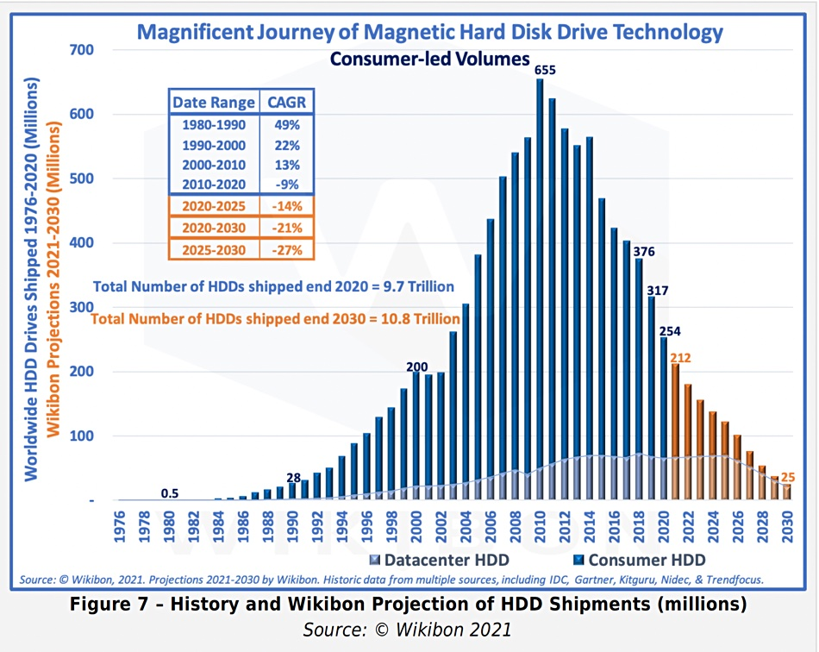
Market Power & Imperfect Market
“In economics, market power refers to the ability of a firm to influence the price at which it sells a product or service to increase economic profit.”
“An imperfect market refers to any economic market that does not meet the rigorous standards of the hypothetical perfectly—or purely—competitive market.”
“Imperfect markets are characterized by having competition for market share, high barriers to entry and exit, different products and services, and a small number of buyers and sellers.”
However, we will be treating market power as the progress of increasing quality, reducing cost, expanding economies of scale & scope, and developing non-imitable or excludable features (differentiation) out of technology possibilities, so that such progress leads to price setting capability by a smart producer to make profit, while compelling others to take lower price and incur loss. Due to it, invisible hands of market keep losing the capacity of setting price, and the number of producers keeps falling-–leading to oligopoly, duopoly or monopoly. We will term such a market situation as imperfect market.
To gain market power for creating imperfect market, a smart producer takes the advantage of discontinuity in the evolution of innovation and starts developing snowball or flywheel effect out of cumulative effect of a flow of incremental ideas. That leads to creating entry barrier due to the growing need for capital investment (R&D and equipment) for both production process and next release of product, increasing scale advantage, growing network externality effects, increasing excludable features, and also rising IP barrier.
Market power
Hard disk makers
1957- 1 (IBM)
1977-entry of Toshiba
1984-75
2009-6
2013-3
Seagate, Toshiba and Western Digital
Exploitation of technology possibilities
In the 1980s, there were 30+ commercial word-processing software packages.

Slide 3
Underlying Factors—fueling market power and creating imperfect market
(i) quality, (ii) IP assets, (iii) brand value, (iv) scale, (v) scope, (v) externality effect, (vi) supply chain, (vii) ecosystem, and (viii) internal R&D
Quality—fitness to purpose keeps increasing due to the addition of ideas in the form of new or improved features.
IP assets—intellectual property assets keep growing with the growth of ideas.
Scale—scale effect increases due to growing R&D and capital investment, growth of willingness to pay, and decreasing marginal cost for replication in.
Scope—a family products are being developed for increasing the scope effect.
Externality effect—appropriate features, standardization, and customer base keeps growing the externality effect.
Supply chain—supply chain for specialized components keeps growing.
Ecosystem—comprising of providers of complementary goods and services providers, infrastructure and logistics services and so on keeps growing.
Internal R&D—excludable internal R&D capacity keeps growing.
R&D for product—keeps exponential growing for releasing successive versions.
R&D for process improvement
Capital investment for process– keeps growing exponentially for taking the advantage of high caliber knowledge and skill features of machines.
Marginal cost—marginal cost for creating each unit of willingness to pay keeps falling.
Price setting capability—it keeps growing
Number of competitors—it grows and declines; profit making opportunity encourages entry, but price setting capability keeps marginal Xing them.
Competition—it grows and starts disappearing
Vertical foreclosure—dependence on common infrastructure (both HW and SW)
(xi) Marginal cost for producing each unit of willingness to pay (WtoP)
(ix) R&D for product & process, and (x) capital investment for process
Performance
Exploitation of technology possibilities
Number of firms & competition
Growth of market power and Imperfect market
Market performance
Exploitation of technology possibilities

Slide 4
Create and Exploit Growing Economies of Scale Advantage out of Technology Possibilities
Cost per unit
M₃
M₁
M₂
Minimum efficient scale (MES)
“In microeconomics, economies of scale are the cost advantages that enterprises obtain due to their scale of operation (typically measured by the amount of output produced), with cost per unit of output decreasing which causes scale increasing.”
From the production point of view, cost per unit keeps falling with the volume as capital investment keeps getting divided among increasing number of units. It keeps falling with the production volume until the average cost equates the marginal cost. Usually, the marginal cost consists of direct or variable cost elements. Conventionally, this is about economies of scale.
To exploit technology possibility, however, economies of scale deserve further elaboration—perhaps, redefinition. We need to keep advancing technology idea portfolio and releasing successive better versions so that minimum efficient scale (MES) point keeps increasing and the cost of production at MES keeps falling (as shown). This is about taking the economies of scale advantage in exploiting technology possibilities. Invariably, the exploitation of this possibility demands growing R&D investment in both product and process innovation, resulting in growing upfront or capital investment. Besides, such capability should be made excludable, otherwise followers will divide the market and limit the capability to reach MES .
However, along with the expansion of MES and the reduction of cost, we need to succeed to keep selling growing volume for enabling production to reach MES. That requirement demands increasing the willingness to pay for the subsequent releases. Therefore, the exploitation of economies of scale advantage demands decreasing cost, expanding MES and also increasing the quality simultaneously. Furthermore, for expanding the demand, the same product should be targeted for addressing additional purposes. It also demands international trade negotiation for exploiting the global demand.
The exploitation of technology possibilities in creating growing economies of scale advantage is a key success criteria. Furthermore, the attainment of this capability keeps gaining price setting capability and monopolizing the market, as it keeps increasing quality, reducing cost, and expanding MES.
C₁
C₂
C₃
Q₁ Q₂ Q₃ Quantity
Technology maturity
M₁ M₂ M₃
Accumulation of ideas out of R&D
Willingness to pay
Technology maturity

Slide 5
Create Economies of Scope Advantage out of Technology Possibilities
“Economies of scope are "efficiencies formed by variety, not volume". In economics, "economies" is synonymous with cost savings and "scope" is synonymous with broadening production/services through diversified products.”
To exploit technology possibilities, we should attempt to develop and roll out a family of products, so that core asset developed once will be shared among the members. As a result, R&D cost per product will fall due to sharing. In some cases, physical facility could also be shared. For example, over the same cable, multiple products like voice, Internet and TV signals could be rolled out. This is about economies of scope advantage within the context of exploiting technology possibilities. It is derived from the developing a family of products around the same technology core asset, as opposed to diversifying randomly.
In many cases, the core asset is developed as software. Hence, the sharing of the same core asset among multiple members offers very high cost saving, as the cost of copying of software is virtually zero. Furthermore, it also offers the scope of offering similar user interfaces or experiences. R&D approach for leveraging economies of scope by developing a family of products—upon variation and commonality analysis—also eases the complexity of maintenance.
To benefit from economies of scope advantage (as reported on April 18, 2021), “German carmaker Daimler will create 1,000 new jobs for software programmers at its S-Class production facility to develop its planned operating system for electric vehicles.”
Average cost per product at MES
Q₁ Q₂ Q₃ Q₄ Q₅ Q₆ Q₇
Number of products using the same core asset
Economies of scope advantage
Advancement of technology possibilities

Slide 6
Develop and Exploit Network Externality Effects
“In economics, a network effect is the phenomenon by which the value or utility a user derives from a good or service depends on the number of users of compatible products. Network effects are typically positive, resulting in a given user deriving more value from a product as other users join the same network.”
Initially, it originated from the dynamics of perceived value in using the telecommunication services. As the joining of a subscriber opens additional communication channel, often, in the order of n² (n is number of subscriber), network externality effect perceived to be exponential in nature.
But technology possibilities is expanding the scope of deriving network externality effects. For example, standardization of infrastructure creates network effects. Similarly, opening the plug-in options for 3rd party goods and services creates network effect. As more people using the product, 3rd party plugin providers keep developing plugins creating further demand for the product.
In fact, network externality effects could be exploited in both the supply and demand sides. For example, we develop a tele-health platforms connecting patients and physicians. As more Physicians keep joining, patients fund increasing value as it opens choices. The same effect happens in the physician side as more patient starts joining. Furthermore, the option of referring patients and features of facilitating patients share their experiences increase the network effect further. This is a vital attribute for offering increasing value and monopolizing the market—bigger is better.
Hence, the exploitation of technology possibilities should focus creating features for increasing perceived value of goods and services as increasing number of consumer and producer start joining the network or value chain.
Perceived value along with the growth of users, and also producers
Exploitation of Technology Possibilities

Slide 7
Create Differentiation for Enhancing Value Creation and Capturing Ability
“In economics and marketing, product differentiation (or simply differentiation) is the process of distinguishing a product or service from others, to make it more attractive to a particular target market.”
Technology possibilities could be exploited in developing, non-imitable or difficult to imitate, unique features for finding answers of questions, such as “Why should a targeted customer buy my product?” and “How can I make my product stand out from the rest?”
For example, Sony brought Walkman or Apple rolled out iPod in creating differentiation. Due to the absence of direct competition, differentiation offers high value extraction capability. Despite the role of intellectual property barriers, differentiation is susceptible to imitation. To retain it, innovators are required to keep adding unique features in successive releases.
Such uniqueness also originates from perfection. For example, Apple focused on differentiation by perfecting technologies sourced the outside. Starting from graphical user interface to Multitouch, Apple sourced more or less all key technologies from the outside. Its differentiation was distilled from perfection, that competitors could not attain easily.
For increasing perfection, innovators also focus on process technologies like robotics and automation.

Slide 8
Price Setting Capability and Monopolization—formation of imperfect market
Intelligent exploitation of technology possibilities for taking the advantage of economies of scale, scope, and network externality effects, and product differentiation is a very powerful strategic tool to offer higher quality at a lower price than competitors can delivery.
As a result, smart innovator succeeds in attaining price setting capability. This is about having the ability to set a price to make profit, while compelling competitors to take lower price and, subsequently, incur loss. Consistent progress along this line leads to gradual weakening, leading to departure, of competitors. For example, although smartphone market has been expanding, LG could not sustain profit making journey. Upon losing money for several years, it was compelled to leave the market.
In fact, highly lucrative markets in exploiting technology possibilities are highly imperfect. With the growth of the industry, monopolization force keeps growing. Furthermore, the digitization of content and service delivery over network accelerates the imperfect market formation, as cost of copying of software and digital content is virtually zero.
For this reason, telecom service has natural tendency of monopoly. In many countries, market led reform has led to transfer of state owned monopoly in the hands of private monopoly. Similarly, on going trend of digitization has a natural tendency of transferring perfect markets into imperfect ones.

Slide 9
Keep Strengthening Monopoly Force
Quality and scale advantage
For some reasons, if we can create a situation to witness that quality keeps growing, cost keeps falling, and minimum efficient scale keeps increasing, we may say that situation has a natural tendency of monopoly.
Unfolding technology possibilities keeps supporting ideas for increasing perceived value, and reducing input needs like material, energy, and labor.
Yes, that needs growing R&D investment. But the marginal cost of replication of R&D output is very low. As a result, scale advantage also keeps growing.
Therefore, it’s feasible to pursue ideas out of technology possibilities for increasing the quality and reducing cost simultaneously. Besides, it increases the minimum efficient scale. Hence, the exploitation of this attribute of technology possibility may create a natural tendency of monopoly.
In fact, there has been growing focus to exploit this aspect of technology possibilities to increase profitability and reduce competition. Therefore, there has been a rising trend of bigger, better, and cheaper producers.
This technology possibility could be exercised even in natural resource industry. For example, some mining companies have been after robotics for extracting minerals at lower cost. Similarly, Rockefeller pursed R&D investment in science and technology for increasing the quality of refined oil and cost of production, leading to monopolization of USA’a petroleum industry.
Cost for creating per unit of WtoP
Quality, Cost and Scale
Progress in exploiting technology possibilities
Attractiveness, competitiveness
Size of a smart firm

Slide 10
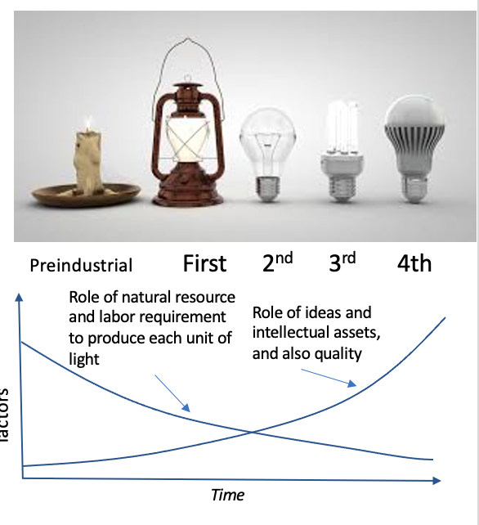
Material, Energy, and Labor Saving Ideas
The exploitation of technology possibilities may lead to ideas for improving the quality and reducing the requirement of material, energy, and labor simultaneously. Often, the cost of the implementation of those ideas is less than savings. As a result, it’s feasible to release successive better versions at less cost.
For example, the replacement of electromechanical relays by photo relays has improved the quality and reduced the cost. Similarly, ideas of using robotics and automation have the potential in improving the precision of operation, lowering defects, and reducing material wastage. The change of the role of hardware by software has a strong role of reducing material and labor requirements.
To exploit this possibility, there has been a strong demand in basic research. For example, Airbus had to make advancement in material science for using composite materials for more than 20% of the A380’s airframe for reducing weight.
The use of 3D printing in producing parts through addition as opposed to subtraction has been also opening the door of reducing material need. Integration of components or developing components having multifunctional abilities have also the potential of making progress along this line.
In fact, ideas for redesign for reducing material, energy and labor need have been a key requirement for producing economic value from technology possibilities.

Slide 11
Ideas as Software and Change the Role of Hardware with Software
Now a days, many of the ideas are being implemented as software feature. Due to the zero cost of copying software, scale advantage has the possibility to keep growing covering the whole market. Of course, producer needs to overcome the challenge of keep creating higher willingness to pay among a growing number of customers. Hence, software based innovation underpins natural tendency of monopoly.
Furthermore, change of the role of hardware components with software also reduces material and energy need. For example, in the 1960s, and 1970s, control systems of aircrafts went through redesign by replacing the role of mechanical control systems with electronic and software—giving fly-by-wire name. It led to significant weight reduction-- “A U.S. Air Force study estimates fly-by-wire controls make it possible to cut the weight of control systems by over 80%, or between 240 and 350 kilograms, depending upon the specific aircraft, and volume reductions of up to four cubic metres.”

Slide 12
Digitization of Goods and Services
Digitization goods and services and their delivery over the network also opens the opportunity of creating natural tendency of monopoly. For example, the digitization of paper money and financial service delivery over digital channels makes cost of material and distance irrelevant.
Digitization of goods and services strongly contribute to economies of scale, scope and externality effects. In fact, they are so strong that invariable digitization has a natural tendency of monopoly.
But the integration of available technologies in transferring goods and services over digital space itself does not create this effect. For example, the creation of monopoly effect in music distribution, there was need for development of standards (like MP3), advancement mobile internet connectivity, and also the progress of smartphones.
Often, sheer benefit of digitization is not good enough in creating needed willingness to pay for expanding the scale effect at profit. It demands significant cumulative effect from a flow of additional ideas. It also demands computability, infrastructure, policy and regulatory framework, and complementary goods and services.
Unfortunately, as opposed to focusing on increasing value out of research, there has been tendency of creating monopoly effect out of subsidies and predatory pricing.

Slide 13
Create Network Externality
Network externality is another factor contributing to natural tendency of monopoly. This is about creating a situation in which perceived value of product keeps growing with the rise of customers. For example, once we transfer medical consultation over networked platform, both healthcare practitioners and patients start experiencing network externality effects.
By the way, in the past, only telephone service delivery used to enjoy network externality effect. Yes, delivering service over the network create network effects. But that is often limited. Additional measures should be taken to develop features for creating network effect. For example, group study features adds network effect to online educational service delivery.
Similarly, 3rd component plugins and developing platform for mediating transactions between producers and consumers significantly contribute to network externality effects. Even simple like option in Facebook has created positive network externality effect. Perhaps, dislike option could have created negative externality effect.
In a digital network business, the employees don’t deliver the product or service—they just design and oversee an automated, algorithm-driven operation.
Although the importance of network effects is well known, less well acknowledged is the fact that the strength of network effects can vary dramatically and can shape both value creation and capture.
https://hbr.org/2019/01/why-some-platforms-thrive-and-others-dont

Slide 14
Develop a Family of Products for Leveraging Scope Advantage
The use of same intellectual assets in developing and offering a family of products create economies of scale effect. This is has been growing due to the ever increasing need for R&D investment and decreasing marginal cost for replication.
“Product-family engineering can be defined as a method that creates an underlying architecture of an organization's product platform. It provides an architecture that is based on commonality as well as planned variabilities. The various product variants can be derived from the basic product family, which creates the opportunity to reuse and differentiate on products in the family. Product-family engineering is conceptually similar to the widespread use of vehicle platforms in the automotive industry.”
Once Nokia used to produce different types of mobile handsets, containing 25 to 30 new products every year. Selling of those products all over the world created the necessity to support many different languages and user interfaces. Nokia faced a severe problem in supporting different user interfaces, because new products succeeded each other very quickly. The application of product family engineering made it possible to create software for the different products and use variability to customize the software to each different mobile phone.
However, Nokia was slow in leveraging it. On the other hand, Apple was far smarter to develop all its products from a core system architecture and software assets. This is one of the reasons that Nokia failed to respond to iPhone’s emergence.

Slide 15
Monopolization—is it always harmful? Profit maximizing pricing and loss of dynamic efficiency
Willingness to Pay
P₁
P₂
Let’s say monopoly starts rolling out the service at price P₁. As the monopoly reduces the price, say from P₁ to P₂, customers grow from N₁ to N₂. Let’s makes the assumption that marginal cost is negligible.
Due to the reduction of price, monopoly gains marginal revenue (N₂-N₁)*P₂. But it will also reduce revenue from existing customers, N₁. This is about inframarginal loss, N₁*(P₁-P₂). A monopoly will keep reducing the price until inframarginal loss equates the marginal revenue.
Once the monopoly reaches the profit maximizing pricing, monopoly will stop reducing the price further. However, society expect the monopoly to reducing price as long as the monopoly remains at profit. But monopoly has no incentive to do it. As a result, society suffer from potential loss of welfare.
Furthermore, monopoly also does not take the risk of making investment in R&D for increasing efficiency so that consumers can get higher quality products at lower cost. As a result, the dynamic efficiency or innovation suffers.
N1 N2 Nmin Customers
Profit
Pmin Prmax Pmax
Price
Sets the price to maximize profit
As price is lowered, marginal revenue and infra-marginal loss take place
As price is lowered from P1 to P2
Marginal revenue: (N2-N1)*P2
Infra-marginal loss:N1*(P1-P2)
Due to profit maximizing, monopoly’s pricing is for profit maximizing.
Dead-weight loss
Socially optimum quantity is not produced

Slide 16
Society Suffers from Deadweight Loss
“Deadweight loss, also known as excess burden, is a measure of lost economic efficiency when the socially optimal quantity of a good or a service is not produced. Non-optimal production can be caused by monopoly pricing in the case of artificial scarcity, a positive or negative externality, a tax or subsidy, or a binding price ceiling or price floor such as a minimum wage.”
For profit maximizing pricing, monopoly does not reduce the price below P_{rmax}. At P_{rmax}, N₁ customers enjoy products by producing Sp₁ consumer and Sp₂ producer surpluses. Let’s assume that P_{min} is the breakeven point. Hence, producer can reduce the price very close to P_{min} without incurring loss. But monopoly does not do it. As a result, N₂-N₁ citizens or customers are deprived from the consumption. Consequentially, society suffer from loss of welfare or economic efficiency as monopoly does not produce socially optimal quantity (N2). This loss of social welfare is deadweight loss, which could be measured as Sp_{3.}
However, this deadweight loss could be reduced by investing in R&D for increasing the willingness to pay or perceived value and also reduce the cost. In retrospect, US Government was quite successful in compelling AT&T to invest in R&D for keep increasing consumer surplus through innovation or dynamic efficiency.
Often the argument in favour of breaking the monopoly is to reduce this deadweight loss by compelling producers to keep reducing price far lower than profit maximising one, due to the effect of a phenomenon known as prisoner's dilemma.
Sp₁
Sp₂
WtP P_{rmax} P_{min}
Sp₃
N1 N2 Customers

Slide 17
Regulating Monopoly for Minimizing Deadweight Loss
Often, regulating monopoly's pricing based on cost modeling has been an option for reducing the deadweight loss. However, it has been found ineffective due to information asymmetry. This is about information gap between the monopoly and the regulator. Furthermore, often, there has been collusion between regulator and monopoly resulting in no advancement in reducing deadweight loss.
However, in addition or as opposed to cost modeling, regulator pay impose performance improvement target. For example, US Government kept imposing increasingly stringent performance and pricing targets on AT&T. To comply with AT&T was aggressively investing in R&D through its Bell Labs. As a result, despite the absence of competition, US consumers kept enjoying increasing quality at decreasing price. On the other hand, surplus for the monopoly also kept increasing. This was happening due to a series of inventions, including Transistor, leading to innovation in telephone switches, transmissions and handsets. Hence, despite information asymmetry, regulator may pursue performance based approach, along with the threat of breaking up monopoly and introducing competition.
However, dishonesty, insincerity and incompetence of bureaucracy limit the option of using performance centric approach in regulating monopoly for increasing social welfare.

Slide 18
Limitations of Monopoly
Despite the natural tendency that monopoly offers the option offering the highest quality at the least cost. It has a number of limitations, such as:
i. For profit maximization, monopoly sets the price higher than the point where social welfare could have been maximized.
ii. Monopoly does not risk investment to innovate, slowing down the dynamic efficiency in offering better quality at lower cost by taking the advantage of technology.
iii. Monopoly often does not pursue supply driven strategy to create the market of innovation.
iv. Due to information asymmetry, regulators often failed to regulate the behavior of monopoly to maximize social well fare

Slide 19
Race of Monopoly Unfolds Technology Possibilities—higher quality at lower price
Although there have been many limitations of monopoly, the race of monopolizing the market by advancing the quality and reducing the cost appears to be blessing for the consumers. Competition takes the role of smart regulation in compelling producers to keep investing in R&D for developing and applying ideas for offering higher quality products at decreasing cost.
For example, in the 1980s, there were more than 30 word processor makers. Similarly, the hard disk industry, in the 1980s, has as high as 75 producers. The race between them kept releasing successive better versions often at less price. However, this journey leads to monopolization. Upon reaching the monopoly state, market starts suffering from lack of progress in innovation and dynamic efficiency, resulting on stagnancy in social welfare.
Interestingly, even in the absence of regulatory intervention, competition of gaining further market share even leads to reinvention, creating another wave of innovation for continued quality enhancement and cost reduction. For example, although hard disk industry has virtual monopoly state, but consumers are benefiting from innovation race in the rising wave of flash drive.
Hence, race for monopoly is not always bad. But if this race keeps buying and burring competitors, there might be a necessity of regulatory intervention.

Slide 20
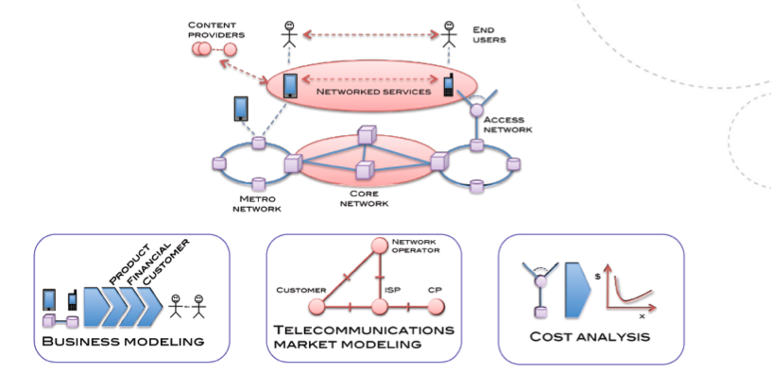
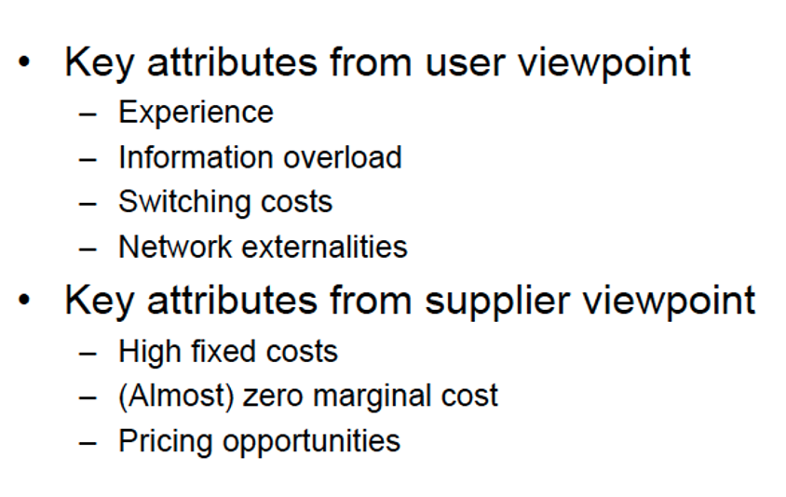
Case of Telecom Industry: Governing Competition in an Industry having Natural Tendency of Monopoly
Due to scale and effect, per unit cost of production keeps falling with the growth of customer base. As the minimum efficient scale is virtually larger than the market size of any country, so this scale effect keeps continuing without facing the limit.
On the other hand, due to network externality effect, perceived value of the subscription of services from the network keeps increasing with the growth of customers. In one hand, there is supply side economies of scale; on the other side, network externality offers demand side economy of scale.
As a result, it’s being found that larger the operator lower cost and better the perceived utility. This inherent characteristic of telecommunication and broadband network is termed as the natural tendency of monopoly. For this reasons, most of the countries, prior to 1980s, used to have single state owned monopoly in the telecom industry.
Per unit cost of production and perceived utility of services
Perceived quality or utility
Cost per unit of service or customer
Customer base of telecom and broadband networks

Slide 21
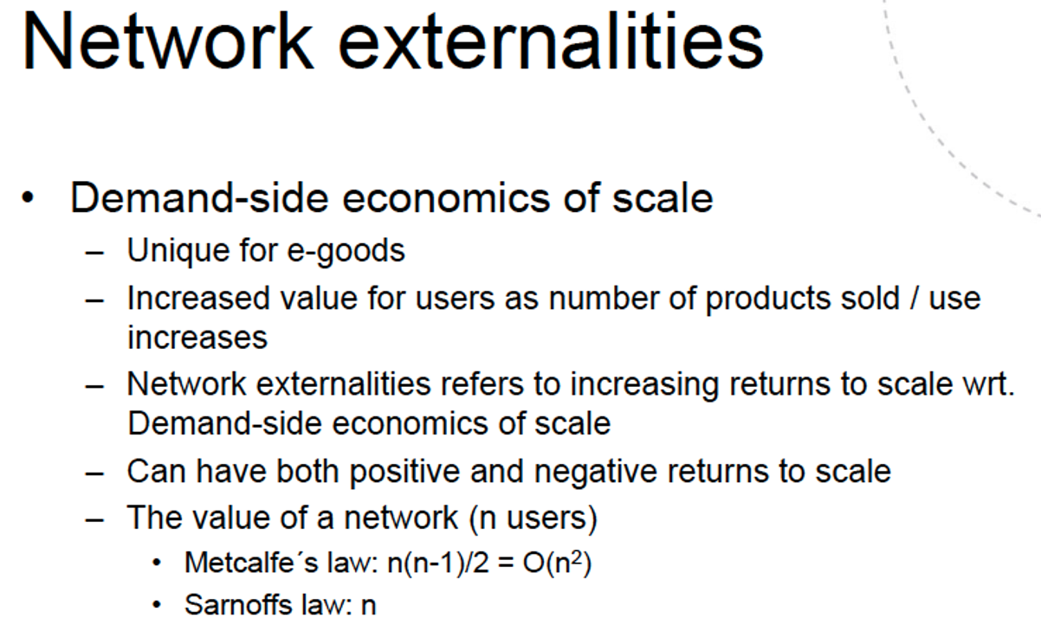
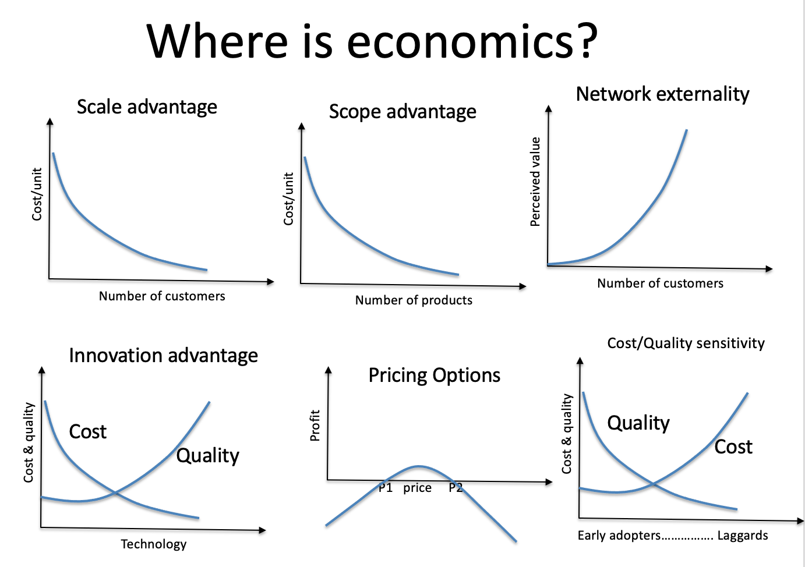
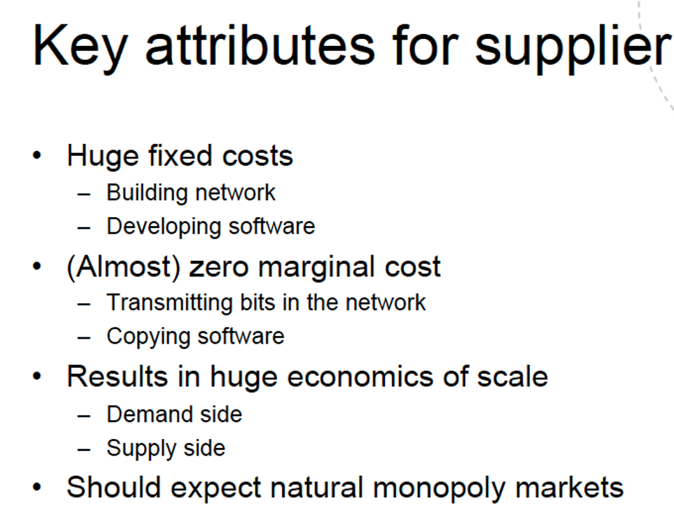
Key Attributes: Natural Tendency of Monopoly
Telecom industry has both natural tendency of monopoly (scale, scope, & externality) and options for attaining price setting capability due to technology possibilities or innovation or dynamic efficiency)

Slide 22
Market Led Reform in Telecommunication
Due to scale, scope and externality effects, bigger the operator lower cost and higher the perceived value. But majority of the countries of the world took a decision to pursue market led reform to replace state-owned monopoly. The reasons varied to the advanced and poor countries, as shown in Table I.
Table I: The drivers behind the starting of market led reform of telecom industry
Advanced or Rich countries | Poor countries
With more or less 100% tele-density, these countries wanted to get rid off of demerits of monopoly. | Due to limited capital, they has small network having very low tele-density, resulting in high cost of service delivery due to very limited scale advantage. To address the capital scarcity, they opened telecom industry to the entry of private firms.

Slide 23
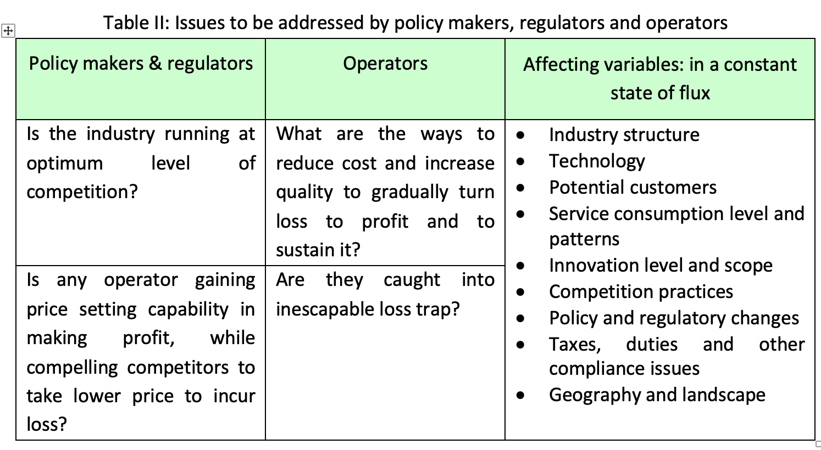
Competition and Governance Challenges
Basically, there are two major stakeholders: (i) policy makers, and (ii) operators. Policy makers are required to face two major questions: (i) is the competition functioning at the optimum level, maximizing the benefit from market led reform?, and (ii) is monopolistic market force growing posing threat to market led reform? On the other hand, operators are required to focus on answering two questions: (i) how to reach to profit?, and (ii) is the journey caught into inescapable loss trap? Let’s elaborate those questions further.
Basically, in constant change of state of flux, two sets of questions, policy makers, regulators and operators should keep investigating, and implementing interventions, as shown in Table II.

Slide 24
Governing Competition at an Optimal Level
As it has been explained, the net benefit from completion does not keep increasing linearly with the level of competition. The level of competition is often linked to the number of total operators. Deciding the optimum number of operators and the scope of operation of those operators is often a serious challenge.
Moreover, the optimum level us function of major factors such as (i) technology, (ii) competition strategy of operators, (iii) market share of each operator, (iv) customer preferences and service consumption behaviors, (v) policy and regulating defining the boundary of each operator, (vi) geography, demography, customer density, and potential customer base, and (vii) innovations.
All these factors are changing. Such changes should be taken into consideration in tracking optimum point, and intervening with policy and regulatory responses to make sure than market keep functioning at the optimum level of competition. To address this vital issue, in-depth analytical work interpreting data within applicable theories should be continually performed.
Net Benefit from competition
Optimum competition, maximum benefit
State-owned monopoly
Extreme competition may turn net benefit negative
Level of competition
Level of competition keeps changing the net benefit from competition in the telecom and broadband market.

Slide 25
Reaching and Sustaining Profitable Operation
Once telecom service delivery used to be highly profitable act. Before the market led reform, state-monopoly in every country used to make healthy profit, giving the impression that it’s a highly profitable industry. But in a competitive market, reaching and sustaining profit often a major challenge for the operators.
Upon receiving the licensee, operators proceed with the deployment of network, making huge upfront capital investment. In a competitive market, deciding about price points is a serious issue. For a monopoly, its straight forward.
The monopoly keeps lowering the reaching as long as the marginal revenue is higher than infra-marginal loss, reaching profit maximizing price point. For in a competitive market, such option is not often available to exercise. Often based on target customer volume, an operator sets the price.
Until and unless that customer volume is reached, cost does not get lower than the price opening profitability, as shown in Fig. 11. For example, an operator sets a price point with the target that once they acquire C₁ customers, the cost of production will be lower than the price, reaching to profit.
Until, they reach this customer base, the operator is required to keep giving subsidy, or incurring loss. In a competitive market, there is a risk of attaining such targets. It may happen that before they reach C₁, no customer is left as all of them already been acquired by competitors, leaving the operator in inescapable loss trap.
Cost per unit
Subsidy or loss
Target price point
Profit
Target cost point
C C₁ C₂ Customers
Figure 11: Challenges in reaching to profit
Before reaching to C1, if inframarginal loss is more than marginal revenue, by lowering the price, you will be deeper in loss, even though you get more customers.

Slide 26
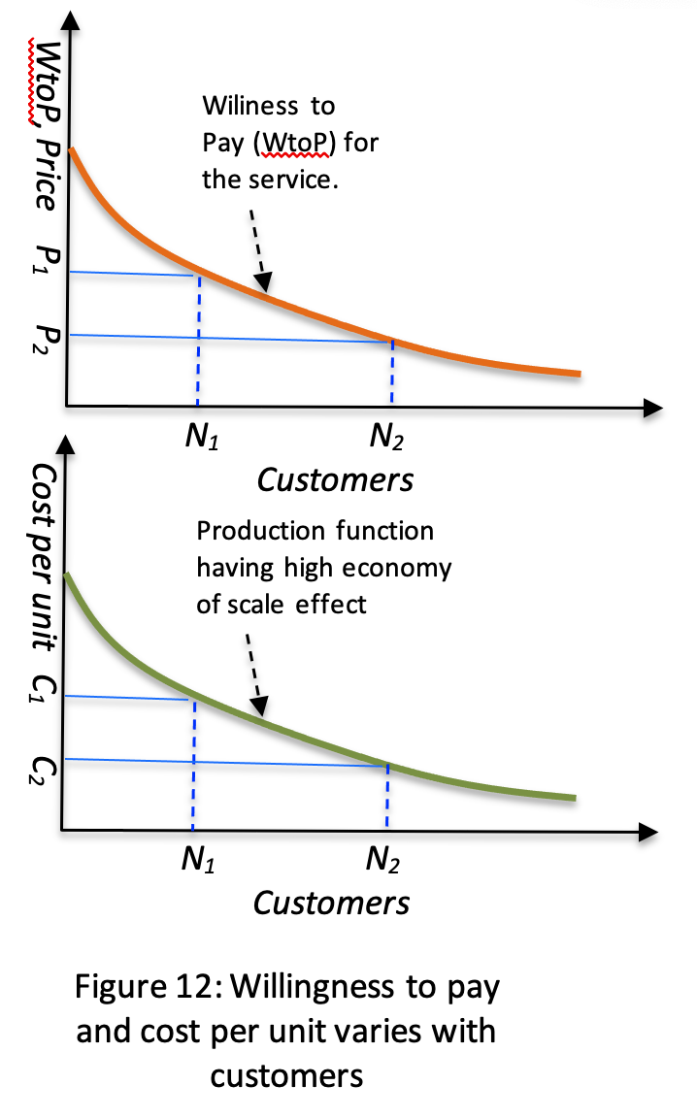
The competition situation gets more complicated when an incumbent operator has already attained substantial market share, say 40 percent. In such a case, an aggressive operator to allure customers practices massive subsidy, often taking the shape of predatory pricing. Such practice is directed in reducing customer bases of incumbent customer, consequentially increasing their cost of production.
On the other hand, by acquiring additional customers the aggressive operator keeps lowering the cost of production by taking the advantage of scale. Not always, an aggressive operator will succeed in reaching to profit by pursuing such strategy.
Before reaching profit, such strategy runs the risk of running out of money to keep giving subsidy to offset loss. Finding the executable pricing window and having adequate fund to absorb loss till the revenue reaches profit are two major challenges

Slide 27
The challenge of reaching profit in a competitive market is explained further. Once a network is set up, certain willingness to pay among customers is created about the service being delivered by the network, as shown in Fig. 12. Due to high economy of scale effect, both production function and willingness to pay characteristics look alike. By reducing the price, operator can increase the number of customers. With the growing customers, the cost per unit of production keeps falling—due to scale effect.
The challenge is to keep reducing the price in reaching to P_{rmin} at which N_{pr} customer is acquired meeting the condition that cost per unit of product, C_{pr}, at that point is smaller than the price being charged—consequentially taking the operator at profit. But, unfortunately, in a competitive market economy, before reaching to this condition often competing operators succeed in taking away all the customers.
At this state, operators find in a position that both the reduction and increase of price leads to increase of loss. The increase of price leads to loss of customers to competitors, consequentially increasing the cost of production. On the other hand, the decrease of price leads to infra-marginal loss exceeding the marginal revenue. Such situation is called inescapable loss trap.

Slide 28
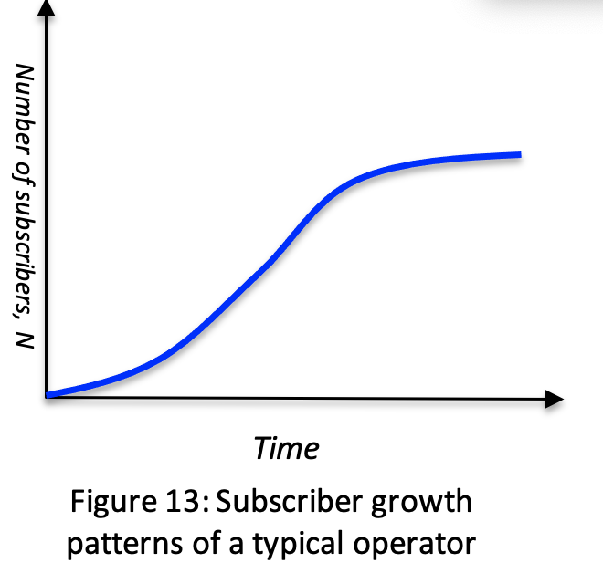
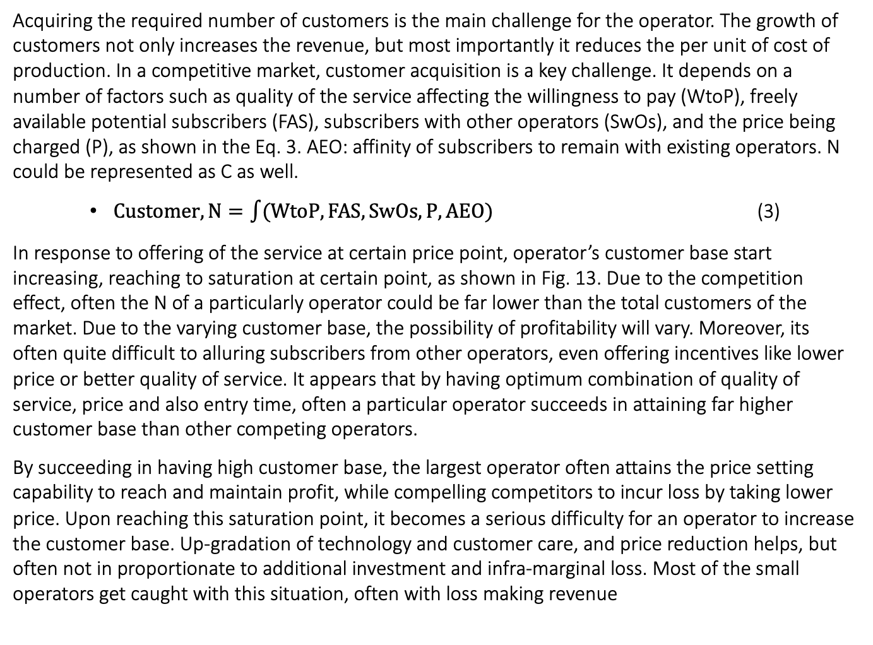
Subscriber Growth Patterns
Acquiring the required number of customers is the main challenge for the operator. The growth of customers not only increases the revenue, but most importantly it reduces the per unit of cost of production. In a competitive market, customer acquisition is a key challenge. It depends on a number of factors such as quality of the service affecting the willingness to pay (WtoP), freely available potential subscribers (FAS), subscribers with other operators (SwOs), and the price being charged (P), as shown in the Eq. 3. AEO: affinity of subscribers to remain with existing operators. N could be represented as C as well.
$Customer, N=\int{(WtoP,FAS,SwOs,P, AEO)}$ (3)
In response to offering of the service at certain price point, operator’s customer base start increasing, reaching to saturation at certain point, as shown in Fig. 13. Due to the competition effect, often the N of a particularly operator could be far lower than the total customers of the market. Due to the varying customer base, the possibility of profitability will vary. Moreover, its often quite difficult to alluring subscribers from other operators, even offering incentives like lower price or better quality of service. It appears that by having optimum combination of quality of service, price and also entry time, often a particular operator succeeds in attaining far higher customer base than other competing operators.
By succeeding in having high customer base, the largest operator often attains the price setting capability to reach and maintain profit, while compelling competitors to incur loss by taking lower price. Upon reaching this saturation point, it becomes a serious difficulty for an operator to increase the customer base. Up-gradation of technology and customer care, and price reduction helps, but often not in proportionate to additional investment and infra-marginal loss. Most of the small operators get caught with this situation, often with loss making revenue

Slide 29
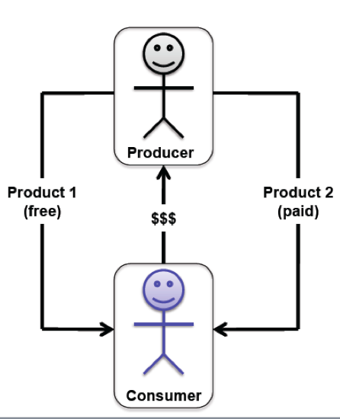
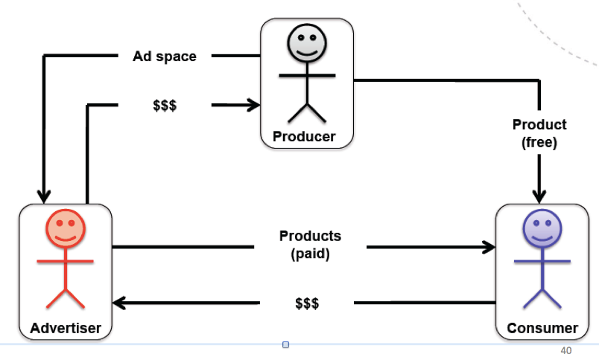
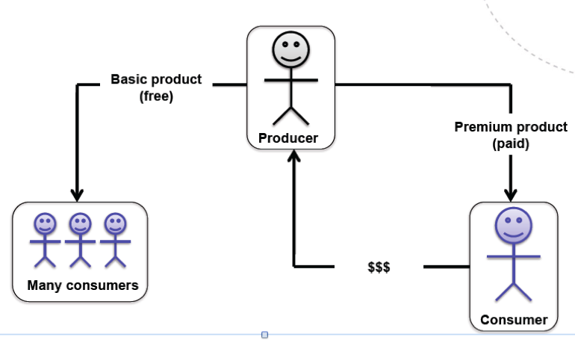
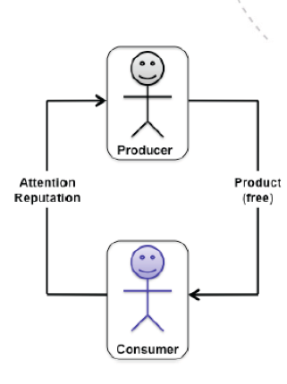
Evolving Business Models—challenging competition and governance space
Direct Cross Subsides
Promoting emerging products
Practicing Predatory Pricing
2. Three party Market
3. Fermium Model
4. Non-monetary Market
Figure 14: Direct cross subsidy
Fig. 15: Advertisement based three party business model.
Fig. 16: Fermium business model.
Figure 17: Non-Monetary market; charitable trusts or voluntary initiatives cover the cost.

Slide 30
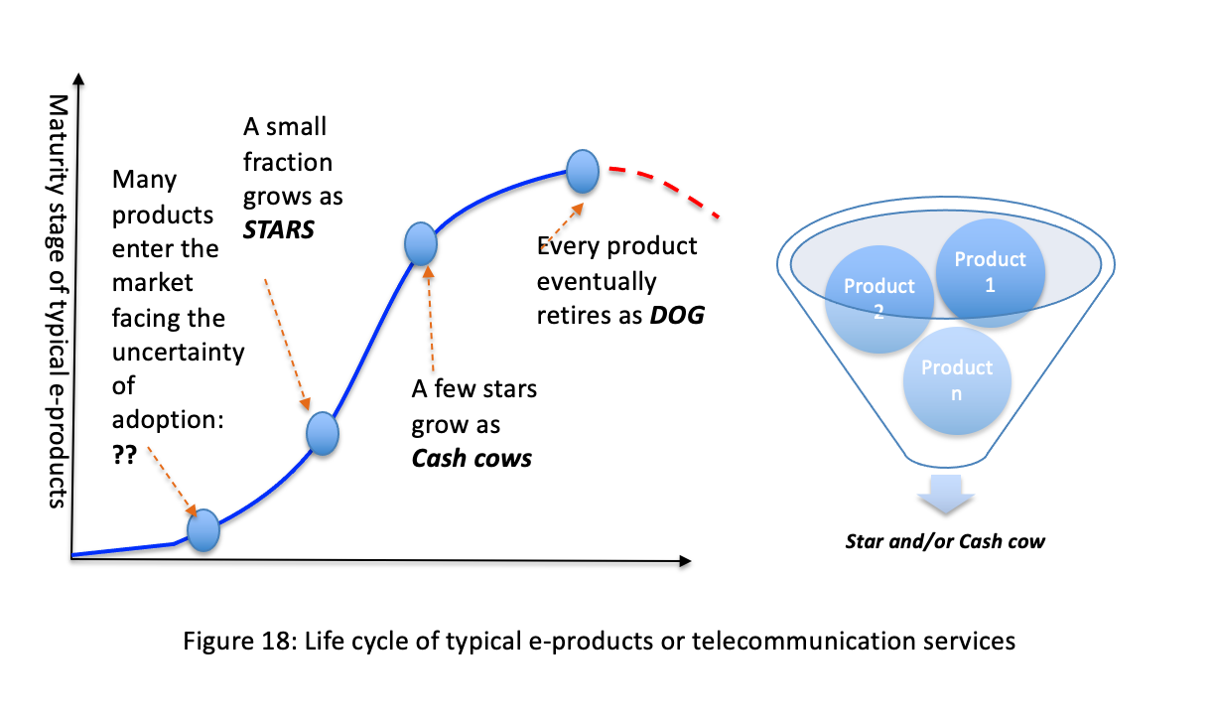
Challenges in Managing Product Portfolio
Defend—Despite showing the erosion trend, revenue flow and market shares of existing products should be defended as much as possible. For example, roll out of data services should be carefully adjusted to defend the voice revenue, so that net profit does not suffer.
Build—Keep strengthening the growth of star products to offset the revenue erosion of cash cow should be a key area of focus. In absence of strong growth in revenues and market shares of stars, defense of cash cow alone will not succeed to offset the erosion.
Pursue—It’s about pursuing new ideas of introducing services leveraging the progression of technology as well customer preference. Despite the uncertainty, a few of them will likely grow as star to offset the revenue loss of cash cow. In absence of pursuing emerging services, operators run the risk of suffering net loss of revenue as well as profit.

Slide 31
Technology Dynamics Create Pressure on Optimum Method of Production
In cellular communication, spectral efficiency has been increasing in successive generations. For example, 4G cellular technology offers the production of 1.40 bits from each Hz of spectrum as opposed to just 0.25 bits in 2G. As next generation of technology shows up before the expire of the previous generation, carefully multiple generation technologies should be blended to attain the optimum technology capacity.
This optimization exercise demands technology forecasting, assessing customer preferences, and estimating revenue implications. Particularly, in a competitive environment, the effect of competitors’ offering should also be taken into consideration. In certain cases, this challenge could be quite daunting.
For example, once it was perceived that WiMax would grow as a strong technology platform to offer wireless broadband services (Fig. 20). Accordingly, many operators across the world laid down networks with this technology. But cellular technology rapidly grew as a strong substitute to WiMax in the data space. As a result, more or less all WiMax operators suffered major loss.
Similarly, wireless local loop also suffered premature obsolesce, as cellular technology with roaming facility became most preferred option. In the space of rapid technology evolution, forecasting should be given due consideration.
Growth of different generation of technologies
Prediction challenge during 2005-2010.
Figure 20: Time of progression

Slide 32
Strategic Options in Governing Competition
i. Segmentation of the industry: To reduce the entry barrier and limit foreclosure strategy, often practiced option is to segment the industry, both vertically and horizontally. For example, the backbone transmission segment is separated from the access network. Restrictions are imposed on the freedom to operate in more than one segment. For example, an access network operator would not be allowed to offer transmission services. Summarily, horizontal segmentation also limits the freedom.
For example, the access network segment could be horizontally segmented as mobile voice ad data provider, wire line data provider, and cable TV service provider. Such segmentation approach in one hand reduces the monopolistic market power accumulation, and reduces entry barrier, but it also reduces the scale and scope advantage.
For example, due to the availability of transmission network provided by 3rd party, the entry barrier in the access network is reduced. On the other hand, in absence of ownership of transmission network, access network operators have far less scope of attaining market power to reduce competition. Moreover, as single transmission network is shared b y multiple access network, scale effect at the transmission segment increases. Appropriate segmentation also prevents operators from exercising foreclosure strategy, by limiting access of certain critical resources to competitors.

Slide 33
ii. Resource sharing: The provision of sharing already developed resources at marginal cost by new as well as existing entrants is about resource sharing. To nurture competition, it has multiple benefits to offer, such as lowering entry barrier, higher scale, and lower scope of market power accumulation.
iii. Preventing predatory pricing: Yes, subsidy is part of the equation building the customer base. For every network, at the beginning subsidy should be given, a it’s virtually impossible to recover the whole network development cost form a small customer base in just couple of years. But such subsidy could be used as a predatory pricing strategy to allure customers from competitors by offer very low price, which market does not support. Through predatory pricing, once a firm succeeds to force competitors to run out of business, monopoly emerges. A fine balanced should be maintained between subsidy and predatory pricing.
iv. Prevent cross subsidizing in leveraging scope advantage: To benefit from scope, often operators are allowed multiple products. For example, mobile operators are allowed to offer both voice and data. Similarly, cable TV operators are encouraged to offer both TV and Internet services over the same network. Leveraging scope advantage also opens the door of cross subsidy. For example, mobile operators can offer data service at very low price by cross subsiding it with the revenue from data. Such cross subsidy practices often create pressure on wire line Internet service provider. By weakening wire line providers, mobile operators prevent the society to benefit from broadband services from wire line connectivity.

Slide 34
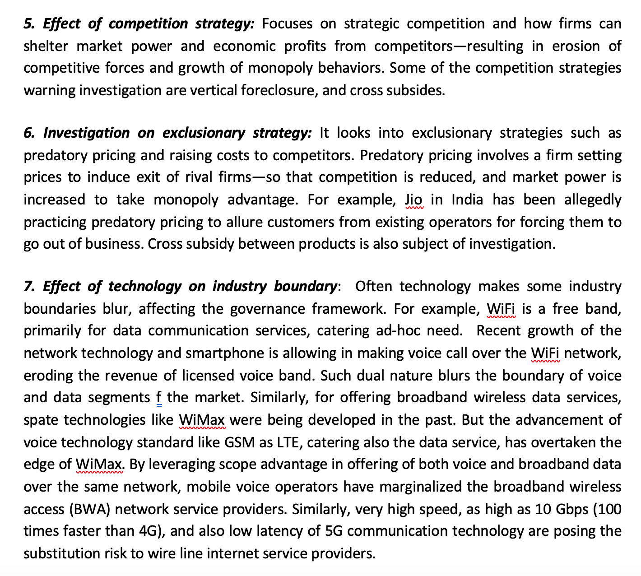

Slide 35
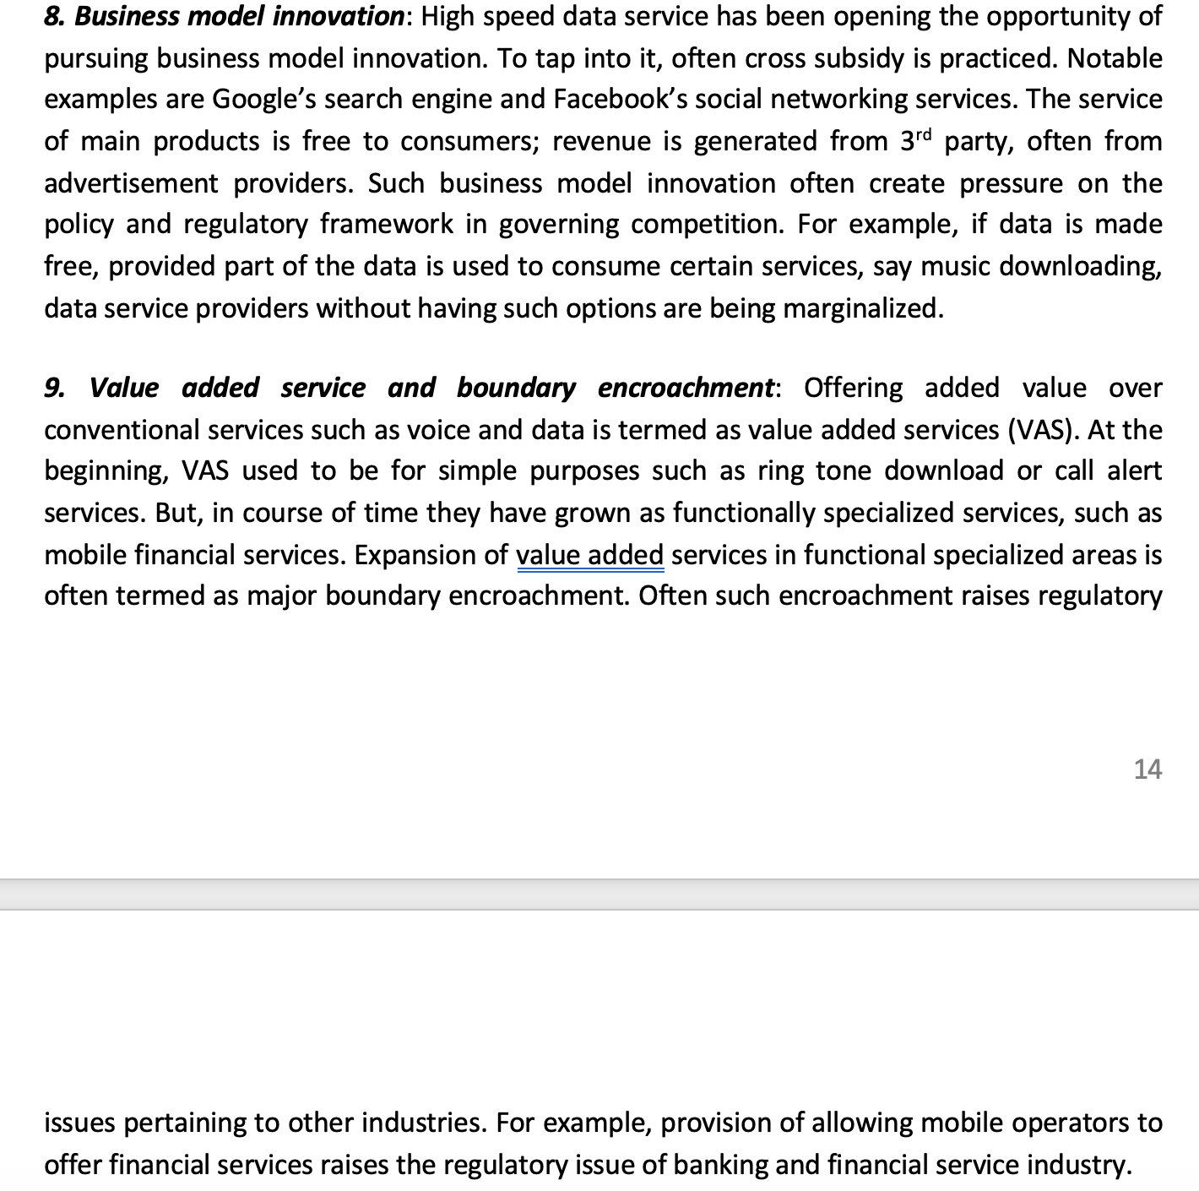

Slide 36
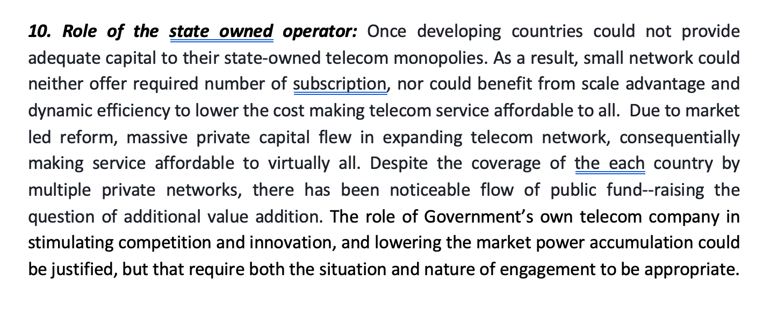

Slide 37
Telecom Industry Segmentation:
The market led reform begins with the segmentation of the industry and issuing licenses to operators. In one hand, segmentation opens the opportunity of reducing natural monopolistic characteristic and wastage of resources; on the other hand, it increases the cost of service delivery. Establishing a fine balance between them in reaching optimum level is a challenge.
A telephone network has four major segments (Fig. 10): 1. International network, 2. International gateway, 3. Domestic backbone network, commonly called backhaul, 4. Interconnection exchange, and 5. Access network and devices.
1. International network
2. International gateway
3. Domestic backbone network
5. Access network and devices
4. Interconnection & number portability exchange
Figure 10: Typical industry structure or value chain of telecom industry

Slide 38
International Network:
International network: The international network basically connects networks of individual countries, offering the opportunity of making calls to anywhere in the world. The international network comprises of both terrestrial and undersea cables, and also satellite. The journey started by laying copper cable between countries through land and as well as under the ocean.
The emergence of satellite communication in the 1960s opened another channel for global connections. Over the last 50 years, fiber optics cable has been gaining its importance in establishing connection between national telephone networks.
Extremely low latency, high capacity and reliability, long life, low maintenance need, and very large economy of scale advantage are the major factors under pining the strength of fiber optics cable. Due to exponential growth of traffic, particularly due to Internet and popular applications like Facebook, YouTube, audio streaming service, and VoIP applications, the cost of sending each unit of traffic over the International network has been rapidly falling. Moreover, competition pursuing innovation and supply driven strategy is also diving down price at the user end.

Slide 39
International Gateway:
International Gateway: It primarily consists of interface between the domestic networks of a country with the international network. Starting from landing station for submarine cables, ground stations for satellites, and MUX/DeMUX (multiplexer and de-multiplexer) from the building blocks of Gateways. These gateways handle international voice calls and data, and Internet data.

Slide 40
Domestic Backbone Network:
Domestic backbone network or backhaul: The domestic transmission network mostly consists of fiber optics network. Majority of the cost, as high as 80 percent, of building such network is incurred for civil works (cost for digging trances and right off way) and laying passive components (like empty ducts, and dark fiber cables).
The remaining 20 percent for is for active components like laser, repeaters, multiplexer, de-multiplexer, and other electronics as well as power components. Moreover, the operation cost is virtually negligible in comparison to the capital cost in building such a network. As each pair of active fiber can carry up to terabits of data, such network offers very high scale advantage. Often a single cable, comprising of dozens of fiber pair, is sufficient to transport the whole traffic of a country.
Due to the high capacity and scale effect, and also capital need, it does not appear to be cost effective for each access network operator to build individual domestic transmission network. The segmenting this segment from other building blocks also decreases the entry barrier being faced by new access network operator.
Moreover, baring access network operator from owning domestic transmission also decreases the acquisition of monopolistic market power. The separation of transmission from the remaining building blocks reduces the chance that an operator will use it to exercise vertical foreclosure strategy in weakening the competition force.

Slide 41
Interconnection and Number Portability Exchange:
Interconnection exchange: In order to address the network externality issue, market led reform has introduced the interconnection exchange. This exchange allows seamless transfer of calls from one network to another. As a result, subscribers of one network do not get isolated from the rest of the subscribers connected to other networks. Such exchange can also play the role of number portability. Often the need for having a number in order to change operator is perceived as switching barrier.
To address it, number portability is being introduced. It’s is a feature for allowing subscribers to change network or operator by keeping the number unchanged. Interconnection exchange between domestic Internet networks offering Internet services (Internet Service Providers or ISPs) also reduces international traffic, as in absence of it often Internet traffic needs to have detour through gateways located outside the domestic boundary, turning every traffic international one.

Slide 42
Access Networks and Devices:
Access network and devices: To the subscribers, access networks are known as telephone or internet service providers. These networks offer subscription to consumers for offering voice, data or video services. There used to be very distinctive five categories of access network providers: i. wire line voice providers or PSTNs (public switched telephone networks), ii. Mobile or cellular operators, iii. Wire line Internet service providers or Internet Service providers (ISPs), iv. Cable TV operators, and v. Wimax (WiFi) or broadband wireless access (BWA) networks.
Technology progression has been opening convergence opportunity. For example, mobile access network has grown to offer broadband Internet services as well. As a result, WiMax or BWA operators have virtually disappeared. Similarly, high data speed of 5G is opening the opportunity of offering Cable TV equivalent video services, marginalizing the unique role of Cable TV network.
Summarily, the emergence of high speed mobile Internet is cornering the role of wire line ISPs. With these access networks, diverse end user devices are connected. Some of the commonly used devices are mobile phone handsets, Tablets, Personal Computers (PCs), and Televisions (TVs). Not only networks, but also access devices are evolving in taking roles of other devices. For example, smartphones are gradually getting popularity in consuming video content. As a result, there has been a tendency in convergence between devices as well as networks. Such convergence is continually blurring the boundary of segmentation, influencing the competition scenario.

Slide 43
Does technology change influence telecom industry structure?
WiFi is improving to handle voice calls using smartphones.
Smartphones are improving to take advantages from WiFi.
What will be likely implication of Voice over WiFi network on the current telecom industry structure?

